Slide 1
Mobile Media Player
Prepared By:
Mahmoud abd El-Sabour Ahmed
Sec : 2

Slide 2
Project Description
It is a mobile application that plays audio and video files.
User select file from list to be played.

Slide 3
Why Mobile application
Mobility has become an essential element for the success of any business
Providing easy access to information form anywhere and at anytime

Slide 4
Tools
J2ME
  Java 2 platform Micro Edition
Sun Java (TM) Wireless Toolkit 2.5 for CLDC.

Slide 5
CLDC
Connected Limited Device Configuration.
It is the configuration that encompass mobile phones and other devices of similar size.

Slide 6
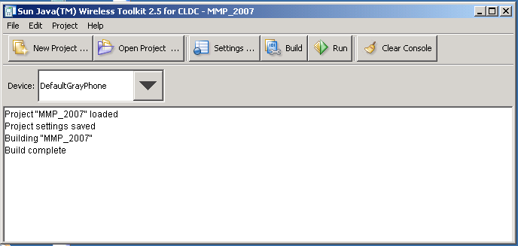
Sun Java (TM) Wireless Toolkit

Slide 7
MIDP
Mobile Information Device Profile
Mobile Information Device Characteristics
-128 of non-volatile memory
-32KB of volatile memory
-A screen of at least 96x54 pixels

Slide 8
MIDLets
It is MIDP application.
Its name come from the continuation of the naming applets and servlets.
MIDLets are developed on regular desktop computers.

Slide 9
MIDLets Structure
MIDLets must goes through these states
    startApp() .
    -MIDlet enter the Active state
    notifyPaused().
    -put MIDLet back in Paused state
    notifyDestroyed().
    -terminate MIDLet execution

Slide 10
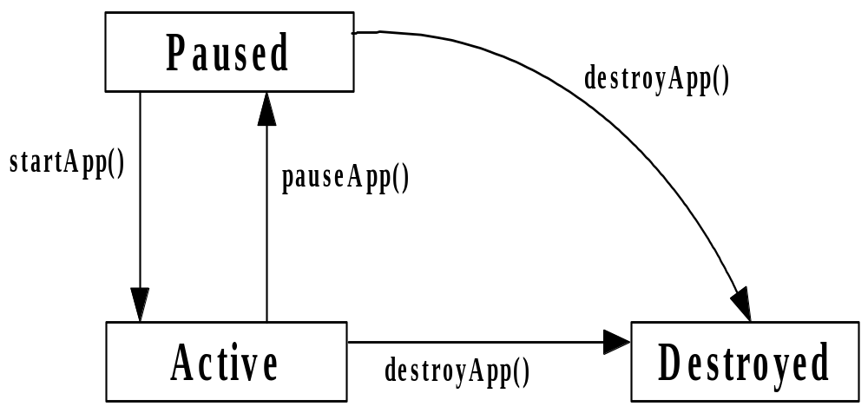
MIDLets Structure

Slide 11
Source Code
import java.util.Hashtable;
-To use hashtable data structure.
import java.util.Enumeration;
-to iterate through the elements of a container
import java.io.*;
-to load files.

Slide 12
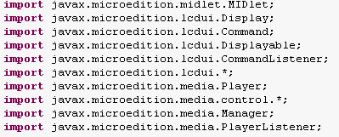
Source Code Cont.

Slide 13
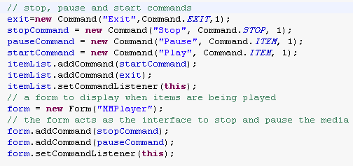
Source Code Cont.

Slide 14
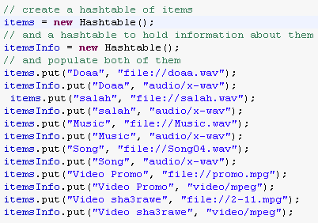
Source Code Cont.

Slide 15
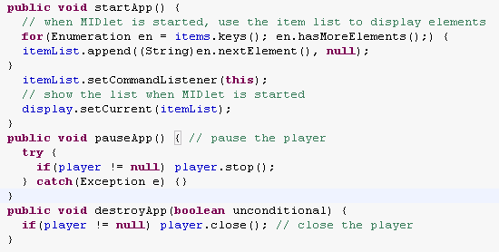
Source Code Cont.

Slide 16
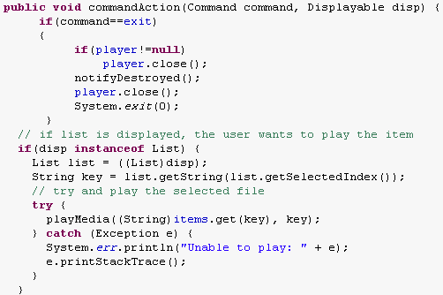
Source Code Cont.

Slide 17
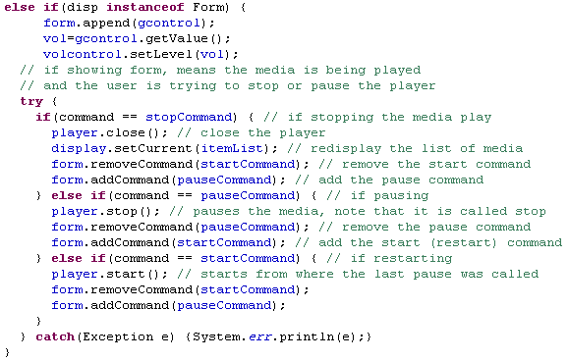
Source Code Cont.

Slide 18
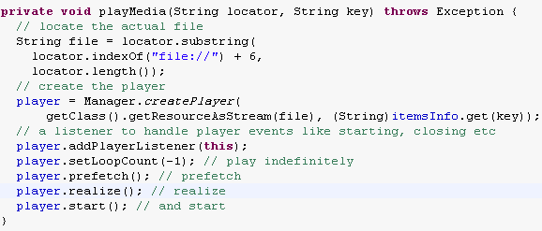
Source Code Cont.

Slide 19
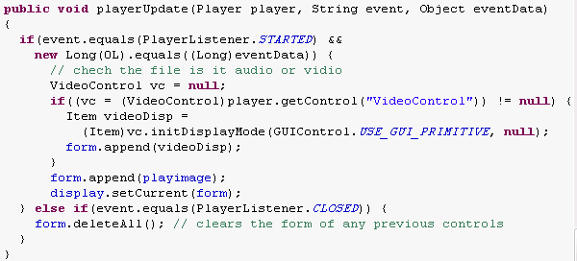
Source Code Cont.

Slide 20
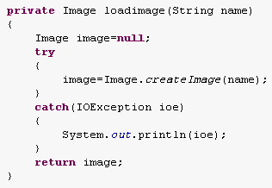
Source Code Cont.

Slide 21
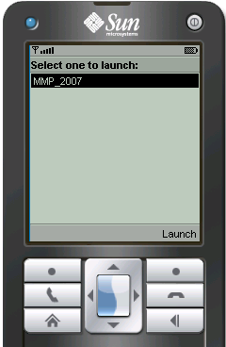
Running the application

Slide 22
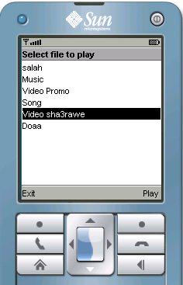
Running the application

Slide 23
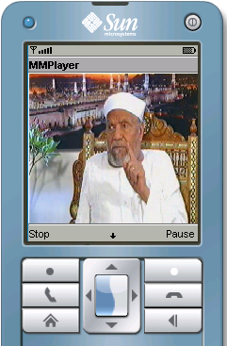
Running the application
Playing video file

Slide 24
Acknowledgment
Thanks for eng\ Majd and eng\ Noha for their support and help.
Thanks for every one who help me either by support or by directing me.

Slide 25
Resources
Java 2 Platform Micro Edition
2nd edition.
www.java.net
J2ME Tutorial, Part 4: Multimedia and
MIDP 2.0 by Vikram Goyal

Slide 26
Thanks

